Slide 1
Physics in Sports Medicine
Unit two Lesson Seven

Slide 2
Introduction
Brainstorm as many words as you can think of that we have been using throughout this unit that you have also heard in terms of physics.
Force
Gravity
Velocity
Acceleration/deceleration
Motion
Friction
Levers
Fulcrum
Energy

Slide 3
Objectives
Understand how basic physics concepts relate to injuries occurring
Use sports medicine to make physics make sense!

Slide 4
What is physics?
Physics studies matter, the way it behaves in space & time, AND the way force & energy affect it.
We are matter, athletics is the behavior, & our muscles, joints, & the world around us create the force & energy causing injuries!

Slide 5
The basics of Force
Force is a type of energy that creates movement in a direction with magnitude
Our muscles shorten to cause our joints to move – internal force
Gravity constantly pulls us back towards earth, especially when our center of gravity changes – external force

Slide 6
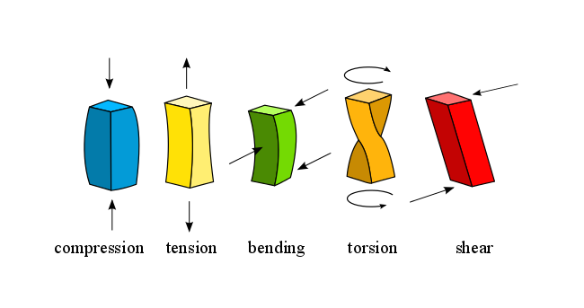
Types of external forces
Compression
Tension
Torsion
Shearing
Bending

Slide 7
Newton’s First Law of Motion
“A body remains at a state of rest or remains in uniform motion until an outside force acts on it.”
Everything wants to stay in its current position!
*Inertia
A weak muscle struggles to start moving its limb
Heavy objects are hard to get moving
Heavy loads at the gym are easier to get moving with a spotter

Slide 8
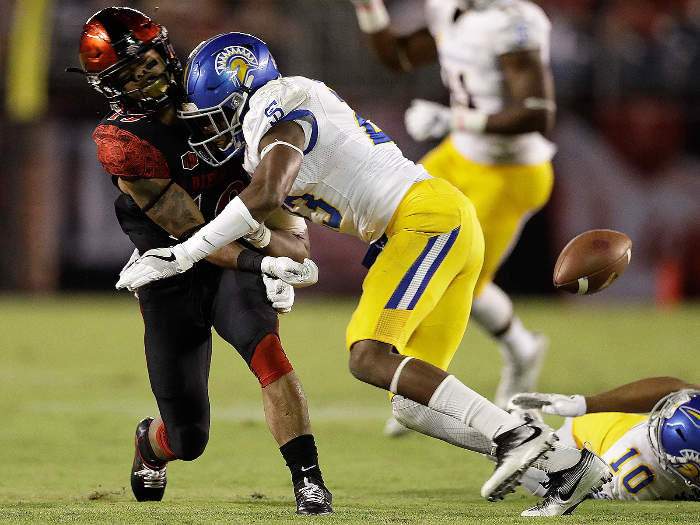
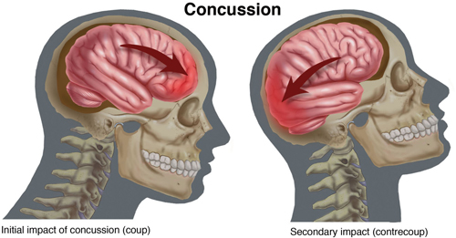
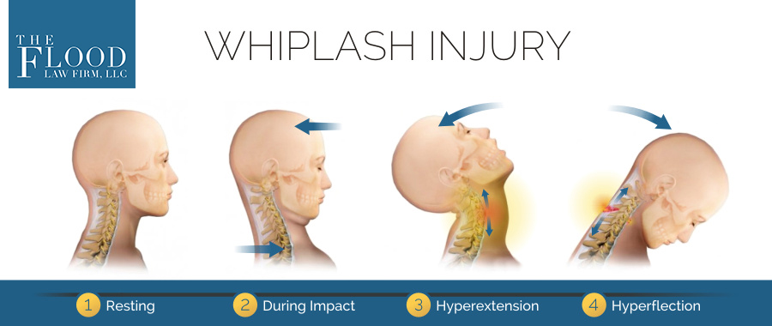
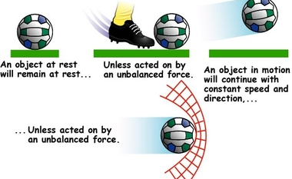

Slide 9
NEWTON’S SECOND LAW OF MOTION
“The acceleration of an object is directly proportional to the force causing motion and inversely proportional to the mass of the object being moved. Momentum is the amount of motion a moving object has.”
It’s easier to move an object with more mass by using a lot of force, but that increase in momentum puts structures at risk of damage!
Strength is not gained through rapid, uncontrolled repetitions
Wires & cables will snap if they are “snapped” against their loads

Slide 10
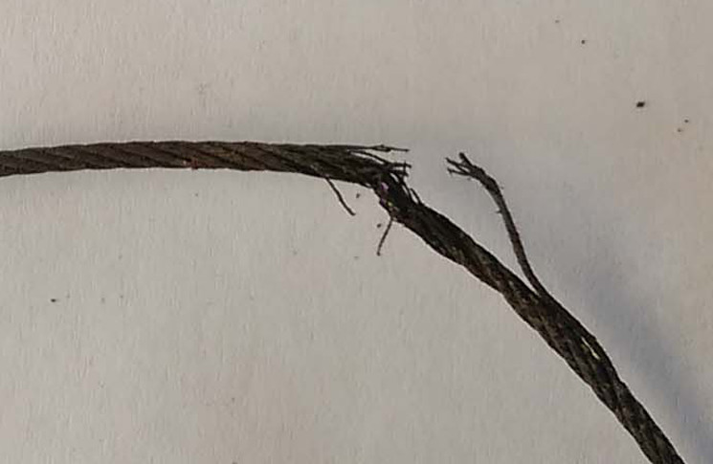
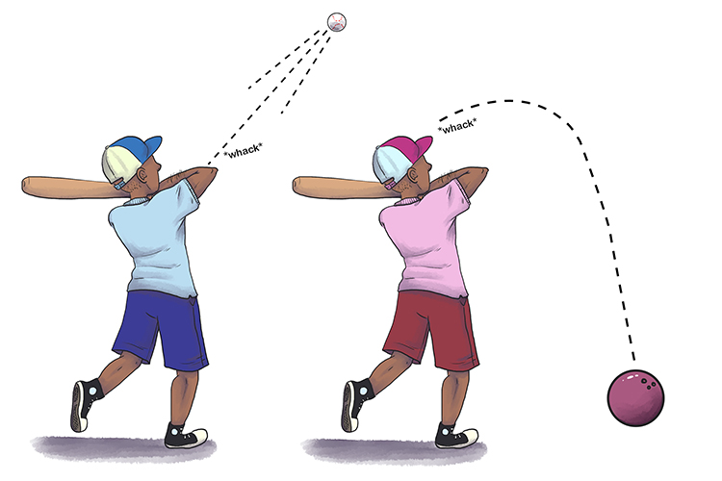
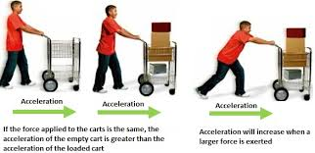

Slide 11
Newton’s third law of motion
The basic explanation of gravity: weight
“An object reacts to a force with a force of equal magnitude in the opposite direction [or] for every action there is an equal and opposite reaction.”
Holding my coffee cup with a bicep contraction & the grip of my hand prevents gravity from pulling its weight to the ground.
The chairs you’re sitting in are pushing against you with the same amount of force as your body weight.
Shooting a basketball requires strength to get it up against gravity & out far enough to make it down & through the hoop!

Slide 12
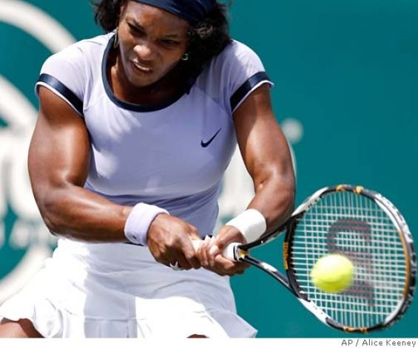
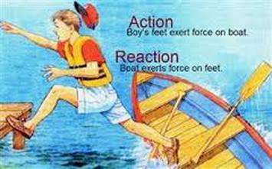
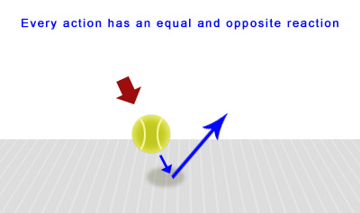
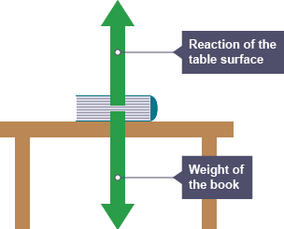
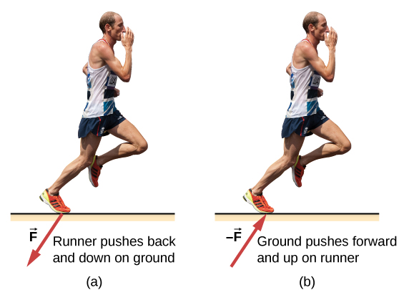

Slide 13
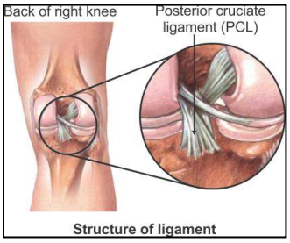
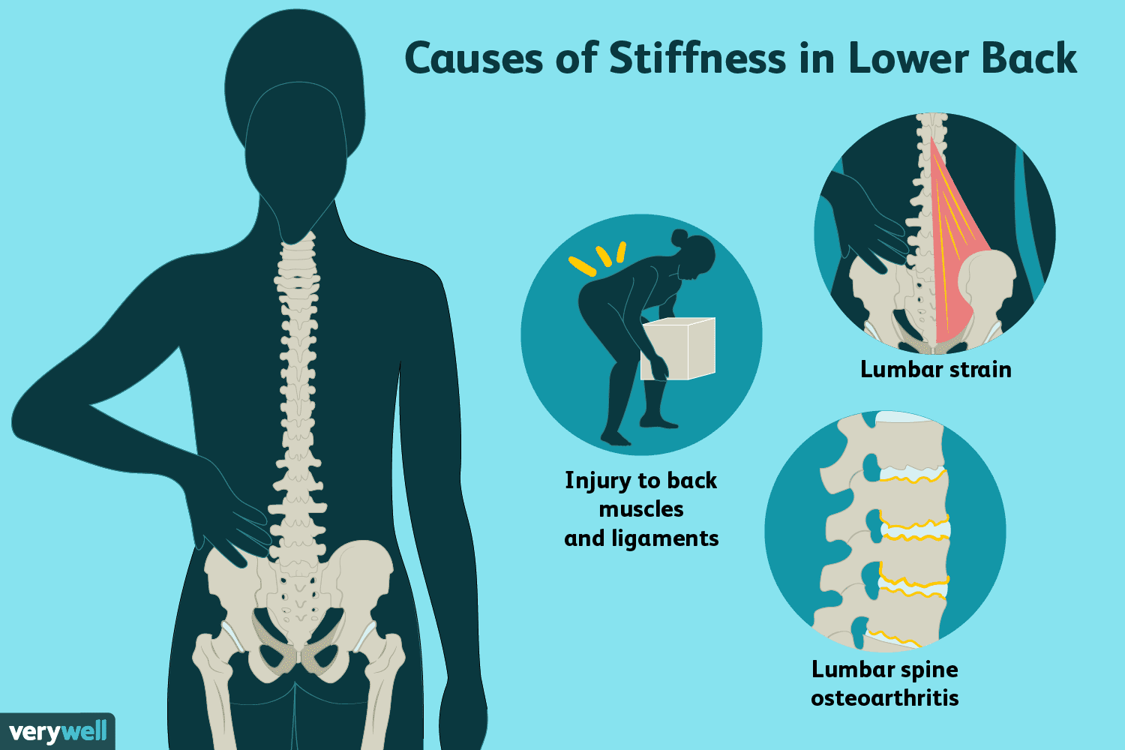
Other physics concepts
Elasticity gives our muscles, ligaments, joint capsules, fascia, & skin ability to stretch but return to their normal anatomical length
All substances are elastic to some degree!
Stiffness is essentially the opposite of elasticity—tissues will resist a change in shape when stress is applied to it
Rapid stresses cause more stiffness compared to gradually loading the tissues!
Muscle tightness following immobilization
Sudden stress to a muscle can cause a spasm

Slide 14
Other physics concepts
Friction is two surfaces’ relative resistance to each other. Sometimes we want it, sometimes we don’t!
Cleats on grass vs. court shoes
Walking delicately on ice vs. walking on grass or cement
Blisters
Broken cables/equipment
Tendonitis
Structural fatigue explains that tissues can only withstand stresses to a certain extent, whether is happens suddenly or over time.
Sprains, strains, ruptures, fractures

Slide 15
Exit Ticket
What are the 5 basic external forces?
List AT LEAST ONE potential injury that each force could cause.

